Slide 1
Bulletproof Transient Error Handling with Polly
Notes:
Abstract:
Connected applications only work when connected. What happens if the network breaks temporarily? Will your system recover smoothly or pitch a fit? Using an OSS project called Polly (available on GitHub) you can handle this and many other transient situations with elegance and fluency. Polly let’s you define resilience and load-handling policies such as retry, wait and retry, circuit breaker, bulkhead isolation and timeouts and more. Learn how to make your system bulletproof with Polly and a little know-how.

Slide 2

Notes:
Story of App vNext.

Slide 3
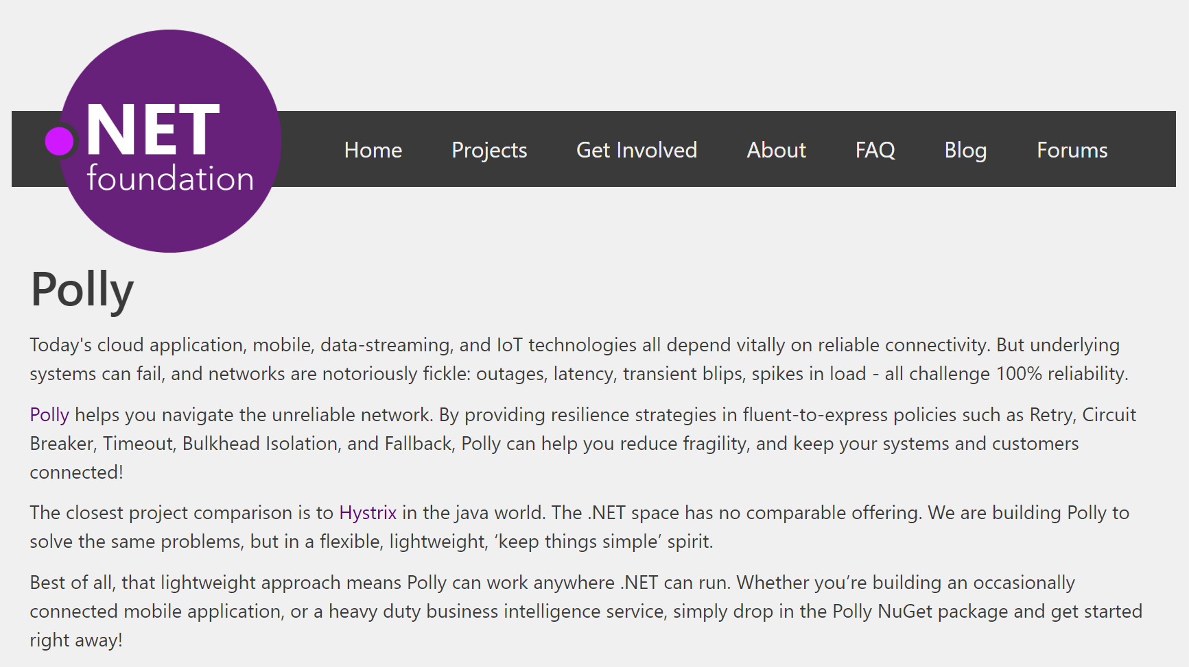
Notes:
Polly was accepted into the .NET Foundation in October, 2016!!

Slide 4
Transient Errors
Network outages
Service outages
Denial of Service attacks
IO locks
Connected device failures

Slide 5
What happens when you flood a struggling service with requests?

Slide 6


Slide 7

Polly to the rescue!
.NET 4.0 / 4.5+ / PCL / .NET Standard / .NET Core
Fluently express transient exception handling policies:
Retry, Circuit Breaker, Timeout,
Bulkhead Isolation, Fallback
https://github.com/App-vNext/Polly
Nuget: Install-Package Polly

Slide 8
Polly offers multiple resilience strategies ...
Retry … ‘Maybe it’s just a blip’
Circuit Breaker … ‘That system is down / struggling’
Timeout … ‘Don’t wait forever!’
Bulkhead isolation … ‘One fault shouldn’t sink the whole ship’
Cache … ‘You’ve asked that one before!’
Fallback … ‘If all else fails … degrade gracefully’
All policies can be combined, for multiple protection!

Slide 9
History of Polly
2013 Michael Wolfenden invents Polly. 2014 Targets multi .NET versions including PCL. 2015 Scott Hanselman (Microsoft) recommends Polly! Thoughtworks (Martin Fowler et al) recommend Polly!
Nov 2015 App-vNext take stewardship Dec 2015 Full async support April 2016 Advanced circuit breaker. Circuit health reporting. June 2016 Handle return values as faults. July 2016 .NET Core / .NET Standard support. October 2016 Timeout, Bulkhead Isolation, Fallback, PolicyWrap May 2017 Mutable context with each execution through a policy

Slide 10
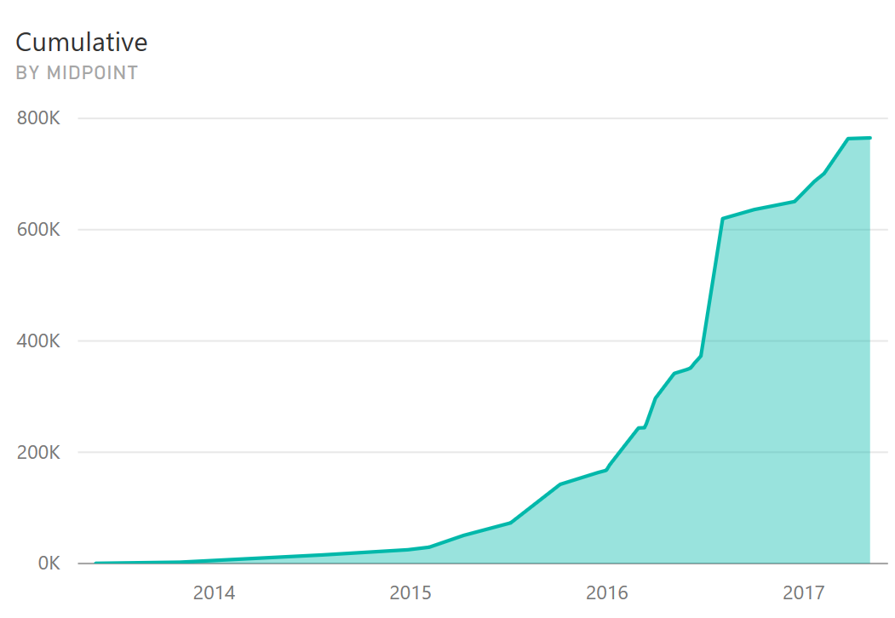
Polly is picking up steam
Polly main package downloads since May, 2013
Cumulative for all Polly packages to date: >820k
30 releases, 22 since AvN took over in late 2015

Slide 11
Step 1: Define Policy
var retryPolicy = Policy
.Handle<EndpointNotFoundException>()
.RetryForeverAsync();

Slide 12
Step 2: Execute with Policy
var response =
await retryPolicy.ExecuteAsync(() => DoSomething());

Slide 13
Retry Patterns
Retry immediately on failure. Specify number of retries.
Wait and Retry Retry with a timeout in between each try. Change the timeout between each retry, eg exponential back-off.
Retry Forever Keep retrying until succeeds.
Retry addresses ... ‘It’s probably a blip. Give it another go - it might succeed.’

Slide 14
Circuit Breaker
Circuit Breaker Breaks the circuit for a configured period if too many errors occur
Blocks calls while circuit is broken.
Protects downstream system - chance to recover.
Fail fast to the caller.
Circuit Breaker addresses … ‘Whoa, that system is struggling / down. Give it a break. And don’t hang around waiting for an answer that’s unlikely, right now!’
Notes:
The ladies in the video having a meltdown: give them a break. Allow them to catch up with the backlogged chocolates horded in front of them. And, stop sending chocolates down the line for a while if they’re only going to be wasted/dropped! (stop putting calls through)
*Original Circuit-Breaker* = too many chocolates in a row get dropped.
*Advanced Circuit-Breaker* = too high proportion of chocolates get dropped.
Ladies throwing chocolates over their shoulders / into mouths = *dropping requests*

Slide 15
Timeout
Timeout Stop waiting once you think an answer will not come
Optimistic mode Co-operative timeout via CancellationToken
Pessimistic mode Enforces timeout (returns to caller) even when governed delegate doesn’t support timeouts/cancellation. Timeout ensures … calls can ‘walk away’ from a faulting downstream system, release blocked threads/connections etc.

Slide 16
Bulkhead Isolation
Bulkhead Prevents one operation from consuming more than its fair share of resources.
Imagine one stream of calls starts faulting slowly...
All threads in a caller could end up waiting on that system … until it starves the caller doing anything else.
Bulkhead prevents this, by limiting the resources (threads) used by separate call streams.
Bulkhead … ‘One fault shouldn’t sink the whole ship!’
Notes:
Underneath is a parallelism throttle to prevent a stream of calls bringing down the whole system. Think of bulkheads on a large ocean liner where, if the hull is damaged and takes on water, then you can close off the other bulkheads to isolate the damage to that one area.
Another strategy of bulkhead isolation is for implementing horizontal scaling. You can monitor bulkhead capacity, that you can use as a metric to automatically scale out services.
Another analogy: You know how supermarkets have separate aisles for checking out shopping carts, versus “baskets only” or “12 items or fewer”? That’s exactly *bulkhead isolation*! Separate capacity/groups of channels, for different operations. If they didn’t have that (was all mixed), and there were a load of large shopping carts going through, the large carts going through would also prevent the people with only small baskets checking out quickly! That’s what bulkhead isolation lets you avoid. Allocate separate channels (sized by your predicted/measured load).

Slide 17
Read-through Cache (forthcoming)
Cache A certain proportion of calls will be duplicates. Serve from cache if you can - reduce latency and save calls.
Pluggable interface - use any cache provider you like.
Supplied providers for Redis, Azure, Amazon Cache, etc.
Cache addresses … ‘You’ve asked that one before!’

Slide 18
Fallback
Fallback Specifies a substitute value to provide (or action to run) when an operation still fails.
Fallback addresses … ‘Failures will occur … prepare how you will respond when that happens’

Slide 19
Policy Wrap
PolicyWrap Combine any of the previous strategies into one concise policy.
PolicyWrap myResilience =
Policy.Wrap(fallback, retry, breaker, timeout);
myResilience.Execute(() => DoSomething());

Slide 20
Policy Basics
Define how transient exceptions should be handled
Fluent and concise
Thread-safe
Reusable across call sites
Sync and async
Chain policies together
Apply to any Action or Func (service calls, data stores, web requests, mobile connectivity)
Notes:
Full async support: accepts and honours cancellation tokens. Full control of continue-on-captured-context or not.

Slide 21
Demos
https://github.com/App-vNext/Polly-Samples

Slide 22
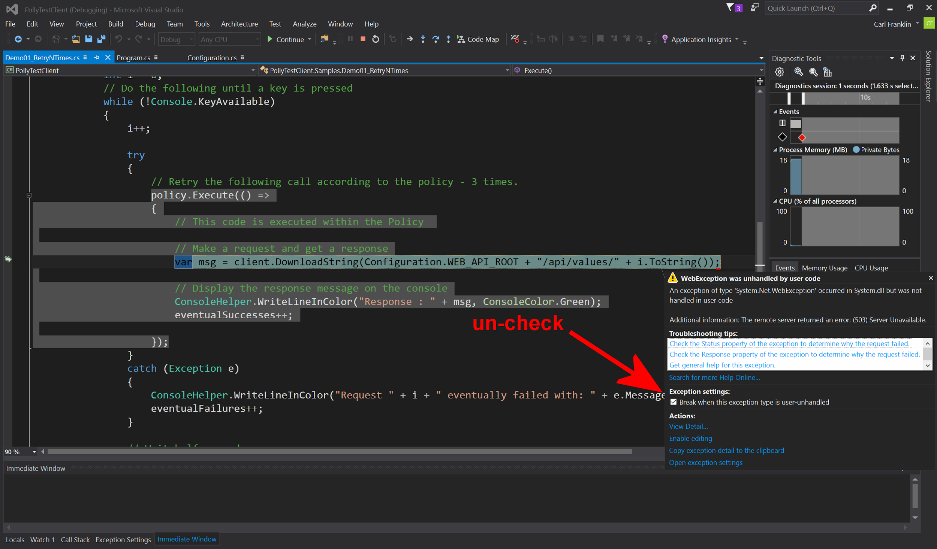
Notes:
Uncheck this tickbox if demoing the Samples out of Visual Studio simply by pressing F5 for Debug. Or ctrl-F5 for start-without-debug.

Slide 23
Further features
Handle multiple exception types in one policy; filter exceptions handled:
var policy = Policy.Handle<SqlException>(ex => ex.Number == 1205)
.Or<TimeoutException>();
Register delegates (onRetry, onBreak etc) to capture policy events, eg for logging.

Slide 24
Further features
Handle both exceptions and return values within the same policy:
int[] httpStatusCodesWorthRetrying = {408, 500, 502, 503, 504};
HttpResponseMessage result = Policy.Handle<HttpResponseException>()
.OrResult<HttpResponseMessage>(r => httpStatusCodesWorthRetrying.Contains(r.StatusCode));

Slide 25
Further features
Define a policy which will simply cause delegates passed for execution to be executed 'as is'.
This is useful for stubbing-out Polly in unit tests, or in application situations where your code architecture might expect a policy, but you simply want to pass the execution through without policy intervention.:
NoOpPolicy noOp = Policy.NoOp()

Slide 26
Future roadmap?
Cache policy
Configure from config
Dynamic reconfiguration Tweak timeouts, circuit-breaker sensitivity etc in production
Telemetry Emit eg circuit health, latency to dashboards, for real-time monitoring
Notes:
All these resilience patterns are brilliantly covered in Michael Nygard’s book Release It!

Slide 27
App vNext Polly team
Carl Franklin .NET Rocks, Music to Code By
Joel Hulen Enterprise software and cloud architect
Dylan Reisenberger .NET coder and enterprise architect, special interest in microservices, messaging, resilience.
… and all you folks who want to make open-source contributions …
https://github.com/App-vNext/Polly/

Slide 28
Polly Wiki
Extended documentation
Configuration recommendations
Patterns
Future Roadmap
https://github.com/App-vNext/Polly/wiki

Slide 29
Polly Slack channel and Blog
http://www.pollytalk.org/ (slack)
Ask questions
Discuss the roadmap
http://www.thepollyproject.org/ (blog)
Project updates, the inside track

Slide 30
THANK YOU!
Notes:
Abstract:
Connected applications only work when connected. What happens if the network breaks temporarily? Will your system recover smoothly or pitch a fit? Using an OSS project called Polly (available on GitHub) you can handle this and many other transient situations with elegance and fluency. Polly let’s you define resilience and load-handling policies such as retry, wait and retry, circuit breaker, bulkhead isolation and timeouts and more. Learn how to make your system bulletproof with Polly and a little know-how.

